Slide 1
FINAL PROJECT
OF CIT COURSE

Slide 2
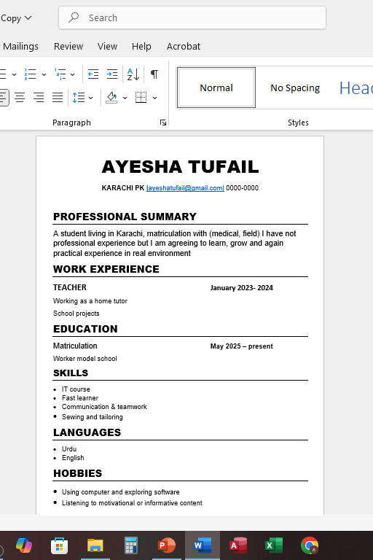
“resume”
This is my CV (Curriculum Vitae), which I created as part of my CIT course. A CV is a document that shows a person's education, skills, and experience.

Slide 3
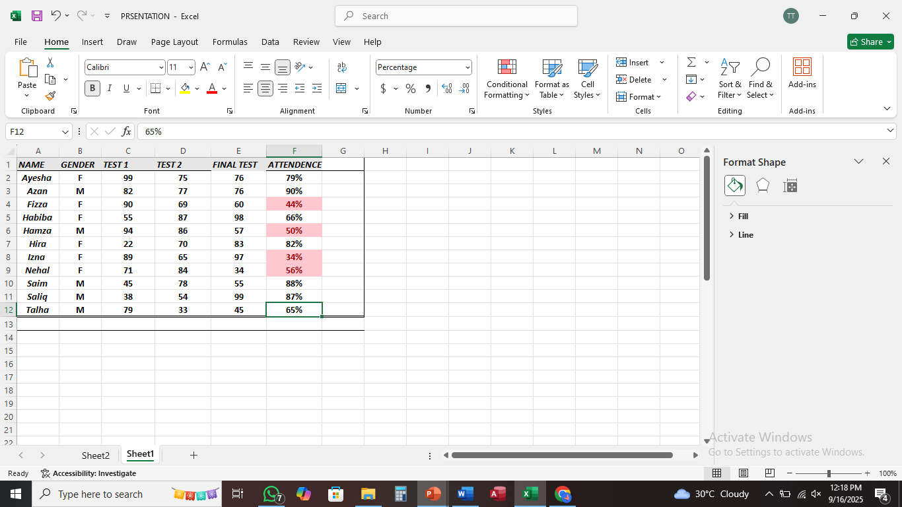
Conditional formatting
It is a Conditional feature that helps analyze data and Formatting highlight important information.

Slide 4
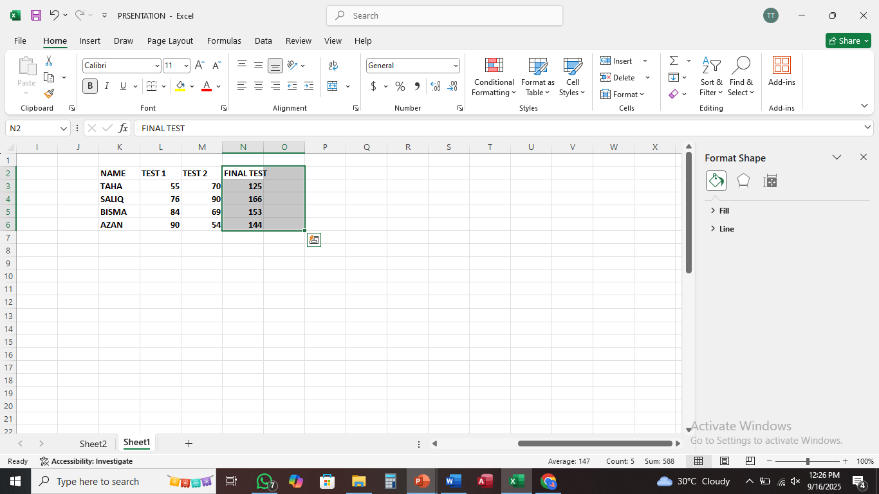
sum
The SUM function is used to add numbers in Excel.

Slide 5
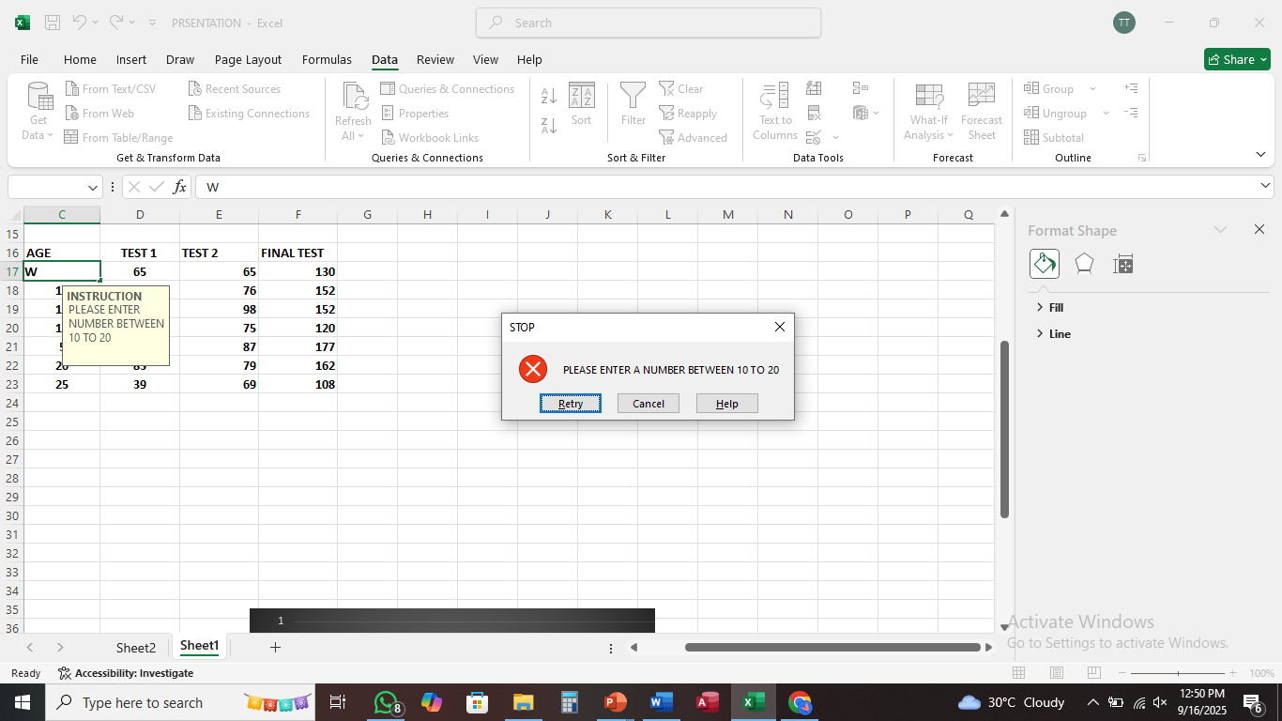
DATA VALIDATION
It helps to prevent incorrect data entry and makes your worksheet more accurate and organized.

Slide 6
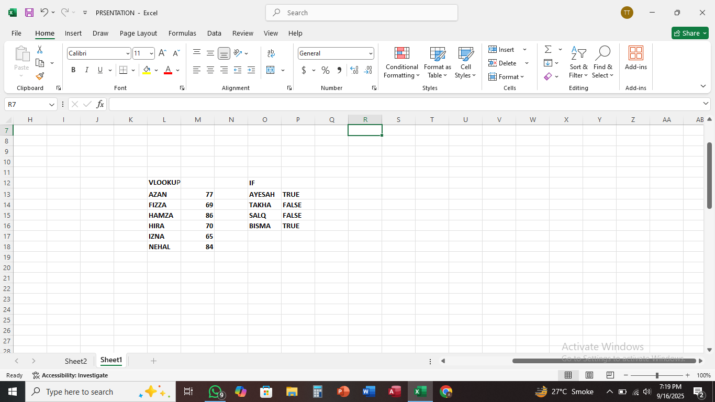
VLOOKUP ANF IF IN.
VLOOKUP helps you find a specific value in a column and return a related value from the same row in another column.
AND
The If condition statement is used in programming to make decisions—it allows the program to execute certain code only if a specific condition is true.

Slide 7
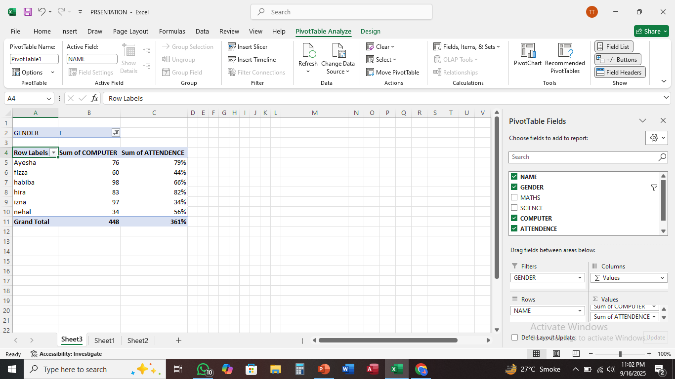
It’s a pivot table in excel
A pivot table use to summarized and
Analyze the data

